Slide 1

T E M I N I P R O J E C T
ATTENDANCE SYSTEM USING FACE DETECTION USING DEEP LEARNING
By: -
Surya Pratap Carol Sebastian Kevin Ruffin

Slide 2

ABSTRACT
01
Tracking and monitoring attendance of students is a vital aspect for any educational institute. Attendance is the main tool to monitor the punctuality of the employees or students in any organization. Although Traditional attendance methods such as roll calling or record book based attendance are out of date and time consuming. Traditional attendance system is susceptible to proxies and mistakes.
Therefore we present “COLLEGE ATTENDANCE SYSTEM USING FACIAL-IMAGE RECOGNITION AND DEEP LEARNING” which uses human facial presence and unique characteristics of the Face of the Student in the classroom at real-time, to ensure accuracy, prevent errors, and proxy attendance.

Slide 3
PROBLEM
STATEMENT
To create an application that which uses human facial presence and unique characteristics of the Face of the Student in the classroom at real-time and in reference to prior mentioned name-labels associated to the recognized faces in the database, mark the attendance of the student.

Slide 4
INTRODUCTION
05
To Create an Application
which aims to take information from college database which includes pictures of all students and detects their presence in the class after the teacher clicks a picture and updates the attendance of students present in the class automatically for the lecture in the records.

Slide 5


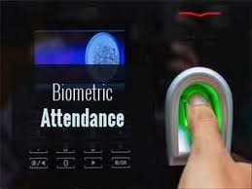
EXISTING SYSTEM
ATTENDANCE BY ROLL CALL
ATTENDANCE BY SIGNATURES
ATTENDANCE BY BIOMETRICS

Slide 6





DRAWBACKS OF EXISTING SYSTEM
PROXY ATTENDANCE
TIME CONSUMPTION
HUMAN ERROR
NO INFORMATION SECURITY
INCONVENIENT TRACKING

Slide 7
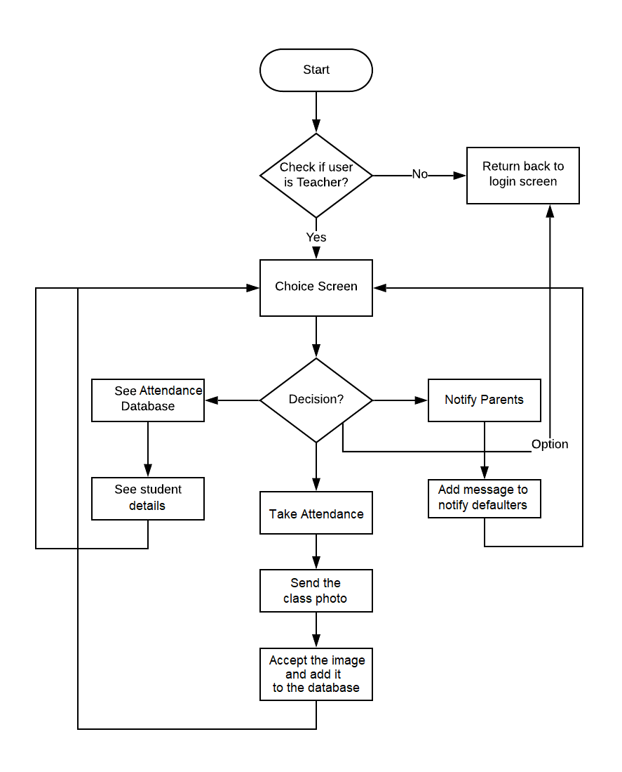
METHODOLOGY

Slide 8
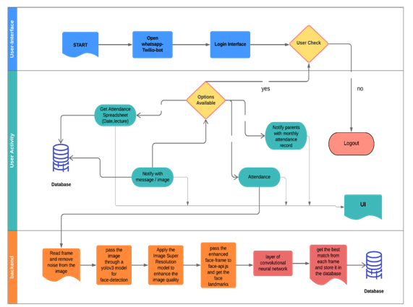
FUNCTIONALITY BASED ARCHITECTURE

Slide 9
ALGORITHM
what we actually want to achieve, is to identify a person given an image of his / her face, e.g. the input image. The way we do that, is to provide one (or more) image(s) for each person we want to recognize, labeled with the persons name, e.g. the reference data. Now we compare the input image to the reference data and find the most similar reference image. If both images are similar enough we output the person’s name, otherwise we output ‘unknown’.
However, two problems remain. Firstly, what if we have an image showing multiple persons and we want to recognize all of them? And secondly, we need to be able to obtain such kind of a similarity metric for two face images in order to compare them…
Face Detection
The answer to the first problem is face detection. Simply put, we will first locate all the faces in the input image. Face-api.js implements multiple face detectors for different usecases.
The most accurate face detector is a SSD (Single Shot Multibox Detector), which is basically a CNN based on MobileNet V1, with some additional box prediction layers stacked on top of the network.
Furthmore, face-api.js implements an optimized Tiny Face Detector, basically an even tinier version of Tiny Yolo v2 utilizing depthwise seperable convolutions instead of regular convolutions, which is a much faster, but slightly less accurate face detector compared to SSD MobileNet V1.
Lastly, there is also a MTCNN (Multi-task Cascaded Convolutional Neural Network) implementation, which is mostly around nowadays for experimental purposes however.
The networks return the bounding boxes of each face, with their corresponding scores, e.g. the probability of each bounding box showing a face. The scores are used to filter the bounding boxes, as it might be that an image does not contain any face at all. Note, that face detection should also be performed even if there is only one person in order to retrieve the bounding box.

Slide 10
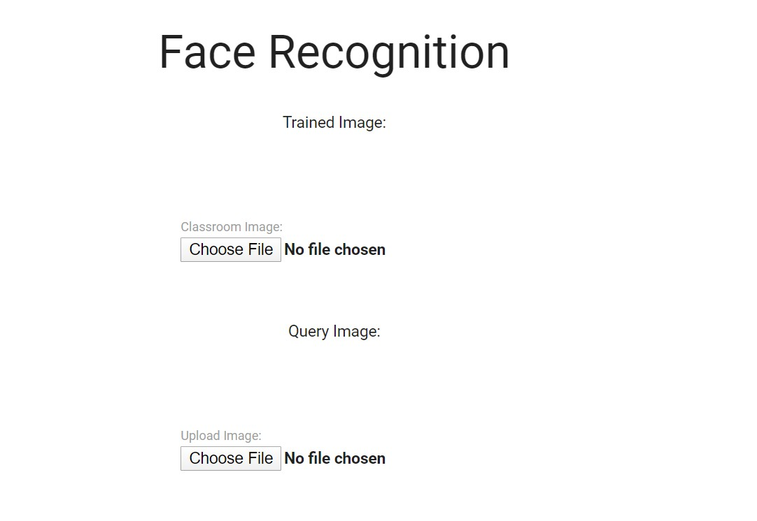
RESULT SCREENSHOTS SOFTWARE INTERFACE

Slide 11
SCREENSHOTS
WHATSAPP INTERFACE

Slide 12
CONCLUSION
05
Maintaining regular attendance is important to create a better environment for quality education in academic institutes. Administrative authorities had to face issues while using traditional based attendance system.
Attendance system using face detection using deep learning is introduced to avoid and curtail these challenges. However, it is important to implement the system with proper planning and training. This Project helps the administrative authorities to monitor the employees or students attendance effectively and efficiently.

Slide 13
REFERENCES
Image-based Face Detection and Recognition
Faizan Ahmad, Aaima Najam and Zeeshan Ahmed University of Beijing
International Journal of Computer Science Issues (IJCSI).
2013
Study of Implementing Automated Attendance System Using Face Recognition Technique
Nirmalya Kar, Mrinal Kanti Debbarma, Ashim Saha, Dwijen Rudra Pal
International Journal of Computer & Communication Engineering, Vol. 1
July 2012
Automatic Attendance Management System Using Face Recognition
Swapna Munigala; Samiha Mirza; Zeba Naseem Fathima; Zubaira M.
CSE Department, Stanley College of Eng. & Technology for Women
IJCSN - International Journal of Computer Science and Network,
April 2019

Slide 14
REFERENCES
Automatic Attendance System Using Deep Learning
Sunil Aryal, Rachhpal Singh, Arnav Sood, Gaurav Thapa
International Conference on Sustainable Computing in Science, Technology & Management
SUSCOM-2019
Smart Attendance Management System
Aman Jobanputra, Shubham Jain, Kruttika Choithani
Department Of Information Technology Thadomal Shahani Eng. College
International Journal of Computer Science Trends and Technology (IJCST)
Sep - Oct 2016
Face Detection and Recognition for Automatic Attendance system
Amulya S, Nisarga , Pilli Siva Gowtham Reddy,Dr. Hariprasad S ,Sunil M
Jain University,Bangalore, India.
International Education & Research Journal [IERJ]
2018

Slide 15
THANK YOU

